Slide 1
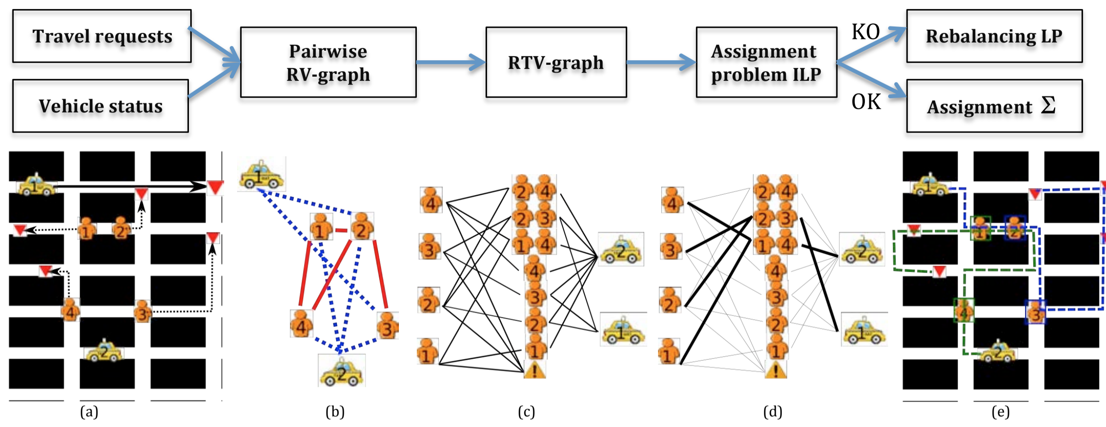
Travel Requests
&
Vehicle Status
Pairwise RV-Graph
RTV-Graph
1
1
2
1
2
1
2
1
4
1
1
1
2
3
3
4
2
3
4
3
4
3
2
4
2
2
4
2
1
3
1
2
3
4

Slide 2
Assignment problem ILP
Assignment Σ
1
2
3
4
5
6
7
8
9
10
1
2
1
1
4
1
2
1
1
2
3
2
3
4
3
4
3
2
4
2
4
2
1
3
1
2
3
4

